Slide 1
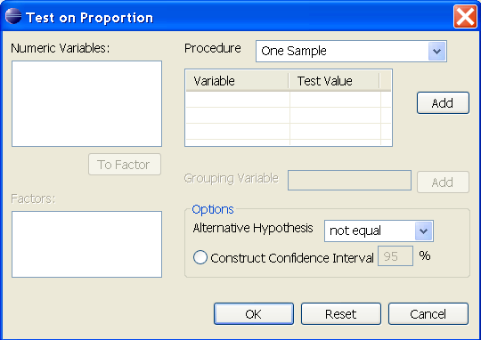
Test on Proportion | One Sample
Only items in the Numeric Data should be transferred here; allow multiple selection; if user select item(s) here the button will be enabled with label Remove
If user enter a variable in the Variable column, the default value of the Test Value is 0.5; User can change the value of the Test Value Column; valid value is between 0 - 1
Only numeric variables should be displayed here; allow multiple selection;
Default value of alternative hypothesis is not equal
If user tick the Construct Confidence Interval the entry would be enable with default value equal to 95; possible value is between 0 - 100

Slide 2
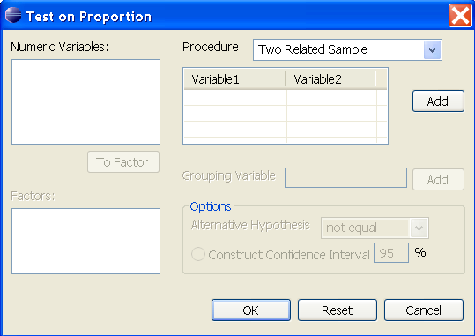
Test on Proportion | Two Related Sample
Only items in the Numeric Data should be transferred here; the first item highlighted should be placed in the Variable1 Column while the second item should be placed in the Variable2 Column; if user click a single cell the label of the button will be replaced with Remove; when user click the Remove button, the cell on focus and its pair will be remove from the table and return to the Numeric Variable dialog box
Only numeric variables should be displayed here; user should select two items before clicking the OK button

Slide 3
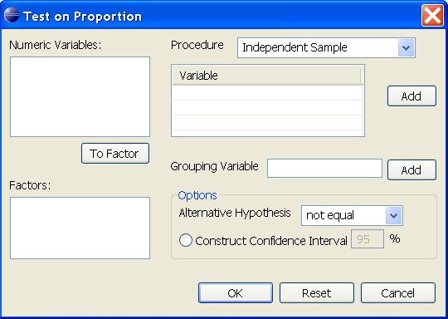
Test on Proportion | Independent Sample
Only items in the Numeric Data should be transferred here; allow multiple selection; if user select item(s) here the button will be enabled with label Remove
Only items in the Factor dialog box should be displayed here; if the entry box has an entry the button should be labeled Remove
Only numeric variables should be displayed here; allow multiple selection;
Default value of alternative hypothesis is not equal
Only factors with two or more categories should be displayed here; single selection only;
If user tick the Construct Confidence Interval the entry would be enable with default value equal to 95; possible value is between 0 - 100

